Slide 1
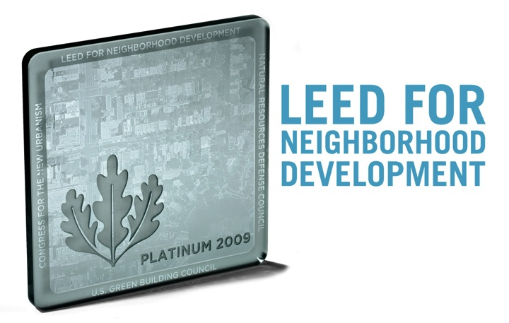
LEED ND
Rating System of Green Business Council
Leadership in Energy & Environmental Design
One of many GBC systems
Building Design & Construction
Interior Design & Construction
Building Operations & Maintenance
Homes
Neighborhood Development
www.usgbc.org

Slide 2
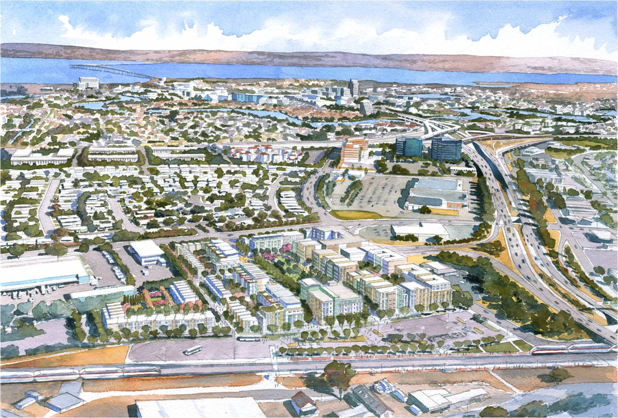
www.raimiassociates.com

Slide 3
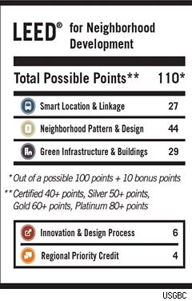
LEED ND
Smart Location & Linkage
27 points
Neighborhood Pattern & Design
44 points
Green Infrastructure & Buildings
29 points
Innovation & Design Process
6 points
Regional Priority Credit
4 points
www.tcrpc-pa.org

Slide 4
LEED Certification
Types of Certificate
Platinum Certificate
Gold Certificate
Silver Certificate
Certificate
Minimum Points Needed
80
60
50
40
Projects have to meet prerequisites; pick and choose other credits
www.dbarchitect.com

Slide 5
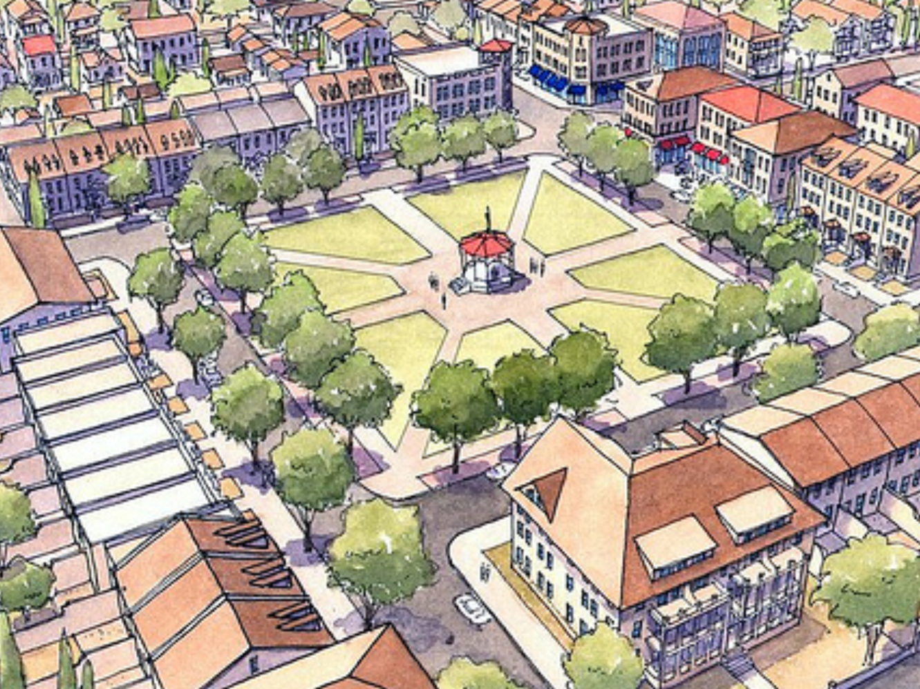
cdn.theatlanticcities.com

Slide 6
Smart Location & Linkage
Smart Location ⇒
Imperiled Species & Ecological Communities
Wetland & Water Body Conservation
Agricultural Land Conservation
Floodplain Avoidance
Preferred Locations ⇒
Brownfields Redevelopment
Reduced Auto Dependence
Bicycle Network & Storage
Housing & Jobs Proximity
Steep Slope Protection
Site Design for Habitat or Wetland Conservation
Restoration of Habitat or Wetlands
Long Term Conservation Management of Habitat or Wetlands
Notes:
Italics are prerequisites

Slide 7
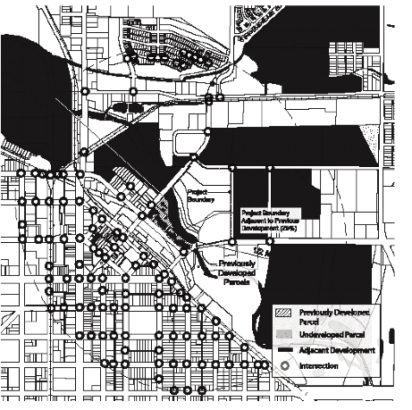
Smart Location
Must be at least one:
Infill site
Adjacent site with connectivity
Intersection density
Nearby adequate transit service
Nearby Neighborhood Assets (Shops, services, facilities)
Option 2: Adjacent Site w/ Connectivity
US GBC (2013) “LEED 2009 for Neighborhood development”
Notes:
OPTION 1. Infill Sites
Locate the project on an infill site.
OR
OPTION 2. Adjacent Sites with Connectivity
Locate the project on an adjacent site (i.e., a site that is adjacent to previously developed land; see Definitions) where the connectivity of the site and adjacent land is at least 90 intersections/square mile as measured within a 1/2-mile distance of a continuous segment of the project boundary, equal to or greater than 25% of the project boundary, that is adjacent to previous development. Existing external and internal intersections may be counted if they were not constructed or funded by the project developer within the past ten years. Locate and/or design the project such that a through-street and/or nonmotorized right-of-way intersects the project boundary at least every 600 feet on average, and at least every 800 feet, connecting it with an existing street and/or right of way outside the project; nonmotorized rights-of-way may count for no more than 20% of the total. The exemptions listed in NPD Prerequisite 3, Connected and Open Community, do not apply to this option.
OPTION 3. Transit Corridor or Route with Adequate Transit Service
Locate the project on a site with existing and/or planned transit service such that at least 50% of dwelling units and nonresidential building entrances (inclusive of existing buildings) are within a 1/4 mile walk distance of bus and/or streetcar stops, or within a 1/2 mile walk distance of bus rapid transit stops, light or heavy rail stations, and/or ferry terminals, and the transit service at those stops
OPTION 4. Sites with Nearby Neighborhood Assets Updated to reflect the 10/1/2012 document addenda for the LEED 2009 for Neighborhood Development Rating System
Include a residential component equaling at least 30% of the project’s total building square footage (exclusive of portions of parking structures devoted exclusively to parking), and locate the project near existing neighborhood shops, services, and facilities (“diverse uses”; see Appendix) such that the project boundary is within 1/4-mile walk distance of at least five diverse uses, or such that the project’s geographic center is within 1/2-mile walk distance of at least seven diverse uses. In either case the qualifying uses must include at least one food retail establishment and at least one use service from each of two other categories, with the following limitations:
a. A single establishment may not be counted in two categories (e.g., a place of worship may be counted only once even if it also contains a daycare facility, and a retail store may be counted only once even if it sells products in several categories).
b. Establishments in a mixed-use building may each count if they are distinctly operated enterprises with separate exterior entrances, but no more than half of the minimum number of diverse uses can be situated in a single building or under a common roof.
c. Only two establishments in a single

Slide 8
Preferred Locations (1-10 points)
Encourage development within existing communities
reduce sprawl
reduce development beyond existing development
conserve natural &financial resources
Points for location type (infill, …), connectivity, federal high-priority locations

Slide 9
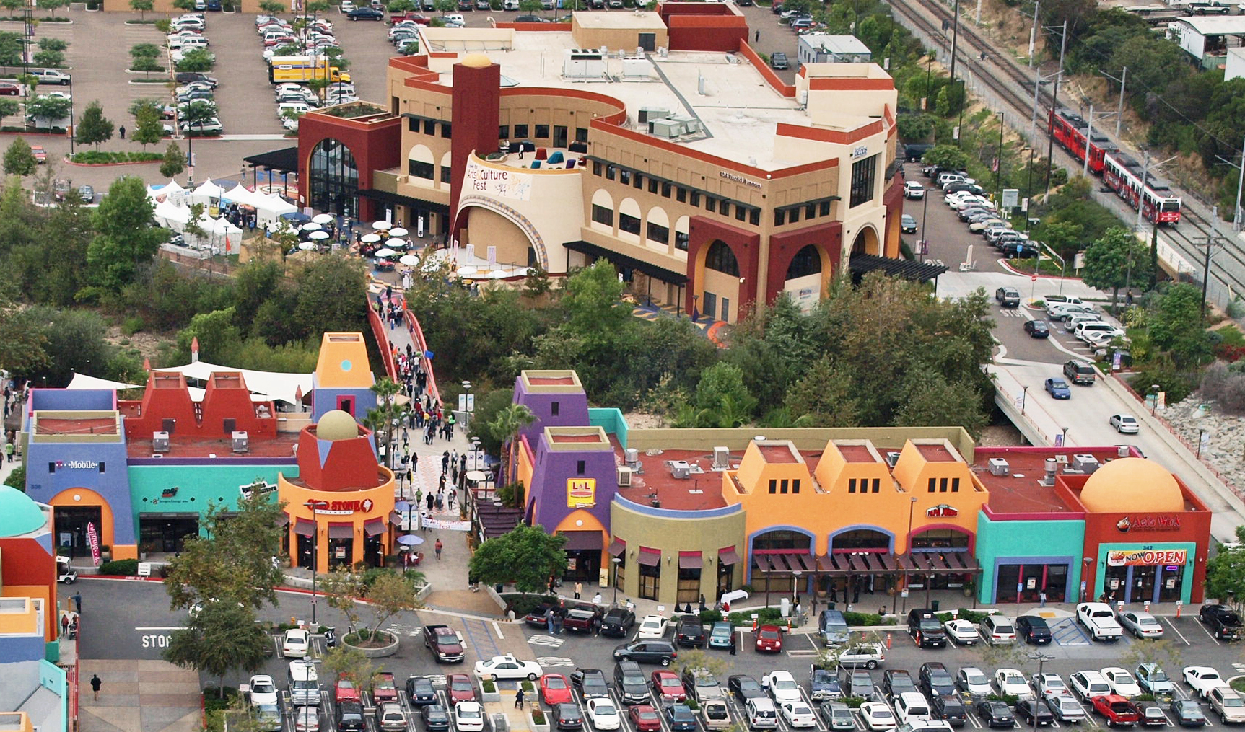
Village at Market Creek (Silver)
synd.yardi.com
84 adjacent acres
Residential, commercial and recreational space
Notes:
Mar. 16, 2012 (MHN Online) The Village at Market Creek Awarded LEED-ND Silver Certification
By Gabriel Circiog, Associate Editor
The Village at Market Creek has become the third project in the country to receive LEED Neighborhood Development approval after receiving a Silver designation under the LEED-ND rating system. The LEED-ND application process for The Village was funded through a grant awarded in partnership by the United States Green Building Council and Bank of America.
The plan calls for the transformation of 84 adjacent acres of deteriorating properties into a cultural “village” that will ultimately include residential, commercial and recreational spaces. The redevelopment aims to integrate these elements around the Euclid transit hub.
Since 1997, over 5,000 residents in partnership with the Jacobs Center for Neighborhood Innovation have helped transform the community into an economically vibrant and sustainable village. In 2010, the Village managed to generate $92.7 million in annual economic activity.
The final plan aims to create 1,000 affordable homes, over 2,000 jobs and 250 new businesses. Approximately 5,500 linear feet of wetlands are expected to be restored, and total surface area of the new construction is expected to exceed 1.6 million square feet. Jacobs Center was assisted by Global Green USA in obtaining the LEED-ND certification.
In other news, Rentv.com reports that San Diego Coffee, Tea & Spice bought a 49,000-square-foot industrial building for $3.75 million. Located at 1722 South Coast Highway, the property was acquired from Lee Enterprises Inc., the parent company of the North County Times.
The seller was represented by Todd Davis and John Orlando from Cassidy Turley BRE Commercial, while the buyer was represented by Tim Clepper of SD Commercial.

Slide 10
Neighborhood Pattern & Design
Walkable Streets ⇒
Compact Development
Connected and Open Community ⇒
Walkable Streets
Compact Development
Mixed-Use Neighborhood Centers
Mixed-Income Diverse Communities
Reduced Parking Footprint
Notes:
Italics are prerequisites
SLL Credit 1: Preferred Locations
1–10 points
Intent
To encourage development within existing cities, suburbs, and towns to reduce adverse environmental and public health effects associated with sprawl. To reduce development pressure beyond the limits of existing development. To conserve natural and financial resources required for construction and maintenance of infrastructure.
Requirements
Achieve any combination of requirements in the following three options:
OPTION 1. Location Type
Locate the project in one of the following locations:
a. A previously developed site that is not an adjacent site or infill site (1 point).
b. An adjacent site that is also a previously developed site (2 points).
c. An infill site that is not a previously developed site (3 points).
d. An infill site that is also a previously developed site (5 points).
AND/OR
OPTION 2. Connectivity
Locate the project in an area that has existing connectivity within 1/2 mile of the project boundary, as listed to Table 1.
Table 1. Points for connectivity within 1/2 mile of project Intersections per square mile Points
≥ 200 and < 250 1
≥ 250 and < 300 2
≥ 300 and < 350 3
≥ 350 and < 400 4
≥ 400 5

Slide 11
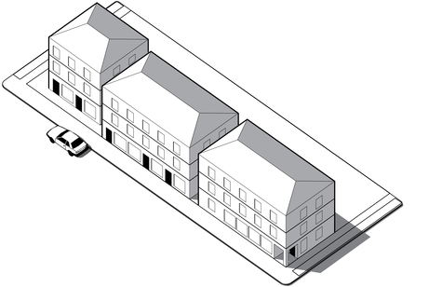
Walkable Streets
www.usgbc.org
Principal entry on public space, not parking lot
90 % new buildings
Min building height: street width is ≥ 1:3
≥ 15 % of existing and new street frontage
Continuous sidewalks or equivalent
90 % of streets (both sides)
Functional building entries at minimum average distances along blocks

Slide 12
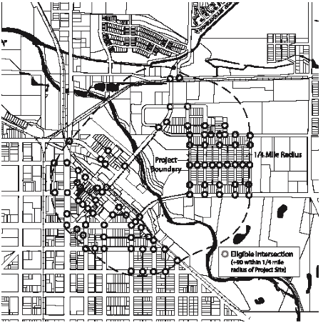
Connected & Open Community
Option 1
140 intersections / mi² &
1 street / 800 ft along boundary
Option 2 (if no internal streets)
existing streets within 1/4 mile of project boundary: ≥ 90 intersections / mi²
Option 2: No internal streets
US GBC (2013) “LEED 2009 for Neighborhood development”
Notes:
OPTION 1. Projects with Internal Streets
Design and build the project such that its internal connectivity is at least 140 intersections per square mile. All streets and sidewalks that are counted toward the connectivity requirement must be available for general public use and not gated. Gated areas are not considered available for public use, with the exception of education and health care campuses and military bases where gates are used for security purposes.
AND
Design and build the project with at least one through-street and/or nonmotorized right-of-way intersecting or terminating at the project boundary at least every 800 feet, or at existing abutting street intervals and intersections, whichever is the shorter distance. Nonmotorized rights-of-way may count for no more than 20% of the total. This does not apply to portions of the boundary where connections cannot be made because of physical obstacles, such as prior platting of property, construction of existing buildings or other barriers, slopes over 15%, wetlands and water bodies, railroad and utility rights-of-way, existing limited-access motor vehicle rights-of-way, and parks and dedicated open space.
OPTION 2. Projects without Internal Streets
Locate the project such that the connectivity of the existing streets within 1/4 mile of the project boundary is at least 90 intersections per square mile. All streets and sidewalks that are counted toward the connectivity requirement must be available for general public use and not gated. Gated areas are not considered available for public use, with the exception of education and health care campuses and military bases where gates are used for security purposes.

Slide 13
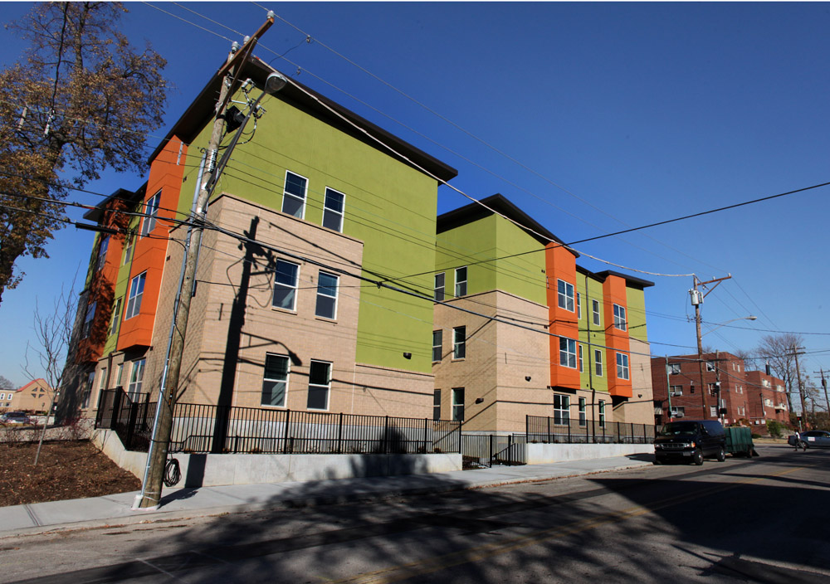
Cincinnati Senior Housing Complex
www.urbancincy.com
Notes:
Avondale celebrates the completion of Cincinnati’s first LEED certified affordable housing development (www.urbancincy.com)
By Kevin Wright ― November 16, 2010
The completion of Cincinnati’s first-ever LEED certified affordable housing complex was celebrated with a ribbon cutting in Avondale last week.
Created for seniors, Forest Square Apartments was developed by The Model Group and designed by City Studios Architecture. The new structure is hard to miss at 3511 Harvey Avenue, as its modern design and colorful exterior stands out amidst the numerous historic homes in the inner-city neighborhood.
The $4.3 million dollar development includes 21 two-bedroom handicap accessible units that offer high efficiency heating, air conditioning, and plumbing. Developers also tout the project’s LEED Silver accreditation, its community garden, kitchenettes, community room, on-site parking, and two outdoor patios.
The project was assisted by a $1 million award from HUD Recovery Act Tax Credit Assistance Program funds that were part of the American Recovery & Reinvestment Act. Local leaders and supporters attended the ribbon cutting, applauding the creative financing of such a unique project during these turbulent economic times.
Speakers also pointed out how important projects like these are during an economic recession, highlighting the fact that this project put people back to work, and produced decent, safe, and affordable housing.
“This project is a key indicator that Avondale is on its way back from being an under-served community,” reiterated Councilman Wendell Young. “This project will provide a safe and healthy environment for our seniors to live in the coming years.”
The project was developed with the Avondale Vision Plan and Burnet Avenue Revitalization Plan in mind as well. Both of which outline ways in which to re-establish Avondale as a safe and affordable neighborhood of choice.
Other agencies involved in the development include the Ohio Housing Financing Agency, HUD, PNC Bank, Avondale Community Council, Uptown Consortium, Key Bank, LISC, Ohio Capital Corporation for Housing, and the City of Cincinnati.

Slide 14
Neighborhood Pattern & Design (cont.)
Street Network
Transit Facilities
Transportation Demand Management ⇒
Access to Civic and Public Space
Access to Recreation Facilities
Visitability and Universal Design ⇒
Community Outreach and Involvement
Local Food Production
Tree-Lined and Shaded Streets
Neighborhood Schools
Notes:
Italics are prerequisites

Slide 15
Transportation Demand Management (1-2 points)
TDM Projects
Reduce weekday peak-period motor vehicle trips by ≥ 20%
Transit Passes
Annual passes for first 3 years, at half price
Developer-Sponsored Transit
For at least 3 years, van-busses & shelters
Vehicle Sharing
50 % of dwelling & nonresidential units within ¼ mile walk distance
Unbundling of Parking
Parking spaces sold separately from residential or non-residential space
Notes:
OPTION 1. TDM Program
Create and implement a comprehensive transportation demand management (TDM) program for the project that reduces weekday peak-period motor vehicle trips by at least 20% compared with a baseline case, and fund the program for a minimum of three years following build-out of the project. The TDM program must be prepared by a qualified transportation professional. Any trip reduction effects of Options 2, 3, 4, or 5 may not be included in calculating the 20% threshold.
OR
OPTION 2. Transit Passes
Provide transit passes valid for at least one year, subsidized to be half of regular price or cheaper, to each occupant locating within the project during the first three years of project occupancy (or longer). Publicize the availability of subsidized transit passes are available to project occupants;
OR
OPTION 3. Developer-Sponsored Transit
Provide year-round, developer-sponsored private transit service (with vans, shuttles, buses) from at least one central point in the project to other major transit facilities, and/or other destinations such as a retail or employment center, with service no less frequent than 45 daily weekday trips and 30 daily weekend trips. The service must begin by the time the project total square footage is 20% occupied and must be guaranteed for at least three years beyond project build-out. Twenty percent occupancy is defined as residents living in 20% of the dwelling units and/or employees working in 20% of the total nonresidential square footage.
Provide transit stop shelters and bicycle racks adequate to meet projected demand but no less than one shelter and one bicycle rack at each transit stop. Shelters must be covered, be at least partially enclosed to buffer wind and rain, and have seating and illumination. Bicycle racks must have a two-point support system for locking the frame and wheels and must be securely affixed to the ground or a building.
OR
OPTION 4. Vehicle Sharing
Locate the project such that 50% of the dwelling units and nonresidential building entrances are within a 1/4 mile walk distance of at least one vehicle in a vehicle-sharing program. For each vehicle, dedicate one parking space accessible to vehicle-sharing members. Through signage and other means, publicize to project occupants the availability and benefits of the vehicle-sharing program. If the project has more than 100 dwelling units and/or employees and has a minimum transit Updated to reflect the 10/1/2012 document addenda for the LEED 2009 for Neighborhood Development Rating System
service of 60 daily weekday trips and 40 daily weekend trips, at least one additional vehicle and parking space for every 100 dwelling units and/or employees must be available. If the project has more than 100 dwelling units and/or employees but does not have transit service at the frequencies specified above, at least one additional vehicle and parking space for every 200 dwelling units and/or employees must be available. Where new vehicle locations are created, a vehicle sharing program must begin by the time the project total square footage is 20% occupied; commit to providing vehicles to the locations for at least two years. Twenty percent occupancy is defined as residents living in 20% of the project dwelling units and/or employees working in 20% of the total nonresidential square footage of the project.
OR
OPTION 5. Unbundling of Parking
For 90% of multiunit residential units and/or nonresidential square footage, the associated parking spaces are sold or rented separately from the dwelling units and/or nonresidential square footage.

Slide 16
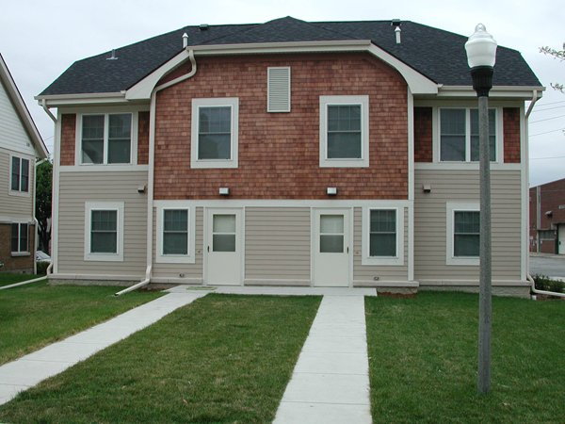
Visitability and Universal Design (1 point)
Increase areas usable by people of diverse abilities
www.independencefirst.org
Notes:
OPTION 1. Projects with Dwelling Units
For each new project dwelling unit of the following residential building types, design to the applicable requirements specified:
Single dwelling unit buildings. Design a minimum of 20% of the dwelling units (and not less than one) in accordance with ICC/ANSI A117.1, Type C, Visitable Unit, each of which has an open-space plan for primary functions (an area for cooking, eating, and social gathering), as well as a sleeping area and a full bathroom.
Multiunit building with two or three dwelling units. Design a minimum of 20% of the dwelling units (and not less than one) in accordance with ICC/ANSI A117.1, Type C, Visitable Unit, each of which has a kitchen, dining area, living area, full bathroom, and bedroom on the accessible level. If a project has both attached and detached single dwelling unit buildings, the requirements apply to each type separately. Similarly, if a project has both 2- and 3- dwelling unit buildings, the requirements apply to each type.
Multiunit buildings with four or more dwelling units. This category includes mixed-use buildings with dwelling units. Design a minimum of 20% of the dwelling units (and not less than one) to incorporate the universal design requirements stated below, or comply with Option 2. Choose at least one of the following three strategies for universal design:
a. Throughout the home, include at least five of the following universal design features to facilitate universal function, access, and user ability:
■ Easy-to-grip lever door handles.
■ Easy-to-grip cabinet and drawer loop handles.
■ Easy-to-grip locking mechanisms on doors and windows.
■ Easy-to-grip single-lever faucet handles.
■ Easy-touch rocker or hands-free switches.
■ Motion-detector lighting at entrance, in hallways and stairwells, and in closets, and motion-detector light switches in garages, utility spaces, and basements.
■ Large, high-contrast print for controls, signals, and the house or unit numbers.
■ A built-in shelf, bench, or table with knee space below, located outside the entry door with weather protection overhead, such as porch or stoop with roof, awning, or other overhead covering.
■ A minimum 32-inch clear door opening width for all doorways.
■ Tread at the entrance, on stairs, and other areas where slipping is common, with color contrast difference between stair treads and risers.
■ Interior floor surfaces (e.g., low-pile carpets, hard-surface flooring) that provide easy passage for a wheelchair or walker, with color contrast between floor surfaces and trim. No carpet is permitted in a kitchen, bathroom, or other wet areas of the dwelling unit. Updated to reflect the 10/1/2012 document addenda for the LEED 2009 for Neighborhood Development Rating System
OR
b. On the main floor of the home (or on another floor, if an elevator or stair lift is provided), provide a kitchen with hard-surface flooring, plumbing with single-lever controls, a 5-foot turning radius, and at least four of the following universal design features to facilitate universal function, access, and user-ability:
■ Variable-height (28- to 42-inch) or adjustable work surfaces, such as countertops, sinks, and/or cooktops.
■ Clear knee space under sink and cooktops (this requirement can be met by installing removable base cabinets or fold-back or self-storing doors), cooktops and ranges with front or side-mounted controls, and wall-mounted ovens at a height to accommodate a seated adult.
■ A toe kick area at the base of lower cabinets with a minimum height of 9 inches, and full-extension drawers and shelves in at least half (by volume) of the cabinets.
■ Contrasting color treatment between countertops, front edges, and floor.
■ Adjustable-height shelves in wall cabinets.
■ Glare-free task lighting to illuminate work areas without too much reflectivity.
OR
c. On the main floor of the building (or on another floor, if an elevator or stair lift is provided), include all of the following:
In at least one accessible bedroom,
■ Size the room to accommodate a twin bed with a 5-foot turning radius around the bed.
■ Install a clothes closet with a 32-inch clear opening with adjustable-height closet rods and shelves.
In at least one full bathroom on the same floor as the bedroom,
■ Provide adequate maneuvering space with a 30-by-48-inch clear floor space at each fixture.
■ Center the toilet 18 inches from any side wall, cabinet, or tub, and allow a 3-foot clear space in front.
■ Install broad blocking in walls around toilet, tub, and/or shower for future placement and relocation of grab bars
■ Provide knee space under the lavatory (this requirement may be met by installing removable base cabinets or fold-back or self-storing doors).
■ Install a long mirror whose bottom is no more than 36 inches above the finished floor and whose top is at least 72 inches high.
In addition, all bathrooms must have hard-surface flooring, all plumbing fixtures must have single-lever controls, and tubs or showers must have hand-held shower heads.
OR
OPTION 2. Projects with Noncompliant Public Rights-of-Way or Accessible Travel Routes
For projects with only nonresidential components, or residential components that are not within the scope of Option 1, but have public rights-of-way or other publicly accessible travel routes within the project that are not in compliance with Americans with Disabilities Act (for private sector and local and state government facilities) or the Architectural Barriers Act (for federally funded facilities), design, construct, and/or retrofit 100% of the rights-of-way and/or travel routes in accordance with the ADA-ABA Accessibility Guidelines, as applicable.

Slide 17
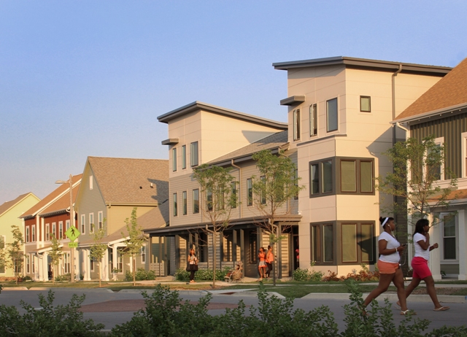
Milwaukee Housing Authority
www.hacm.org
Notes:
Westlawn Gardens Certified as World's Highest-Rated LEED Neighborhood Development (www.hacm.org)
MILWAUKEE – Two Housing Authority of the City of Milwaukee developments, Westlawn Gardens and Olga Village, have earned prestigious international energy efficiency awards.
Westlawn Gardens has achieved Leadership in Energy & Environmental Design for Neighborhood Development (LEED-ND) Stage 3 Silver Certification, placing it at the top of an elite group of LEED certified developments that emphasize sustainability. As the world’s first LEED-ND Stage 3 Silver-certified project, it is the highest-rated neighborhood under current LEED standards (v2009).
“This innovative project represents a new vision for sustainable and affordable housing projects,” said Milwaukee Mayor Tom Barrett. “Westlawn Gardens is a true example of how social, environmental and financial sustainability can be achieved within a public housing project’s limited budget. It proves that even low- and moderate-income communities can vibrantly revitalize themselves through smart growth and appropriate design choices.”
Westlawn Gardens, a redevelopment of the eastern half of the former Westlawn development, includes multifamily buildings, townhomes, and single-family homes housing more than 300 residents. The residential portion of the development is now 100-percent leased, providing essential housing for the north side mixed-income neighborhood.
LEED-ND recognizes development projects that successfully protect and enhance the overall health, environment and quality of life in a neighborhood. LEED-ND projects provide exemplary examples of smart growth, urbanism and green building. The design of the 33-acre Westlawn Gardens neighborhood includes a number of sustainable features, including a 30,000-square foot community garden and sustainable food production program, geothermal heated and cooled apartment buildings, bioswale rain gardens, weather-resistant low maintenance exterior finishes, high walkability, and smart design choices, all of which qualified it for this certification.
Westlawn Gardens also features Milwaukee’s first LEED Platinum-certified home, the highest level of certification available. LEED for Homes recognizes homes that are designed and built for energy and resource efficiency as well as leading to more healthy and durable environments for occupants.
Olga Village, a senior apartment development, has also received a Silver LEED certification for its green building practices. In addition, it has been awarded an “outstanding public energy efficiency project” distinction from State & Local Energy Report, a major national industry publication. Olga Village is located on the campus of the United Community Center on Milwaukee’s south side.
“It is asignificant honor to receive these recognitions,” said Housing Authority Secretary-Executive Director Tony Pérez. “We have prioritized energy-efficiency innovation and incorporated leading-edge design in our projects, which saves taxpayers money and gives our residents additional pride in their homes. These recognitions validate the work we do.”
State & Local Energy Report recognized Olga Village as one of four outstanding public energy efficiency projects nationwide. The building received the New Construction award in the publication’s National Residential Energy Efficiency Awards.
Olga Village received this distinction after implementing a wide variety of sustainable approaches and energy efficiencies in its design and construction. The Housing Authority enacted a number of measures, including the installation of a 26-panel solar array on the roof and condensing gas boilers that will cut energy use for domestic hot water by 63 percent. In addition, the Housing Authority built ground-source heat pumps that connect to a 300-foot-deep water loop, anticipated to achieve a 62-percent decrease in the energy needed for heating and cooling at Olga Village.
Olga Village and the attached UCC Senior Center bring affordable senior housing and an expanded community space to the city’s south side. The development includes 37 affordable homes for seniors and more space for community activities.
“Through our partnership with the Housing Authority of the City of Milwaukee, Olga Village has not only provided a new home to many low-income seniors, but with the expanded UCC Senior Center, we have seen a record-high utilization of our services of recreation, health and nutrition for seniors. This project has been of huge benefit to the seniors living on the city’s south side,” said Ricardo Diaz, executive director of the United Community Center. “With reduced energy use, the project provides an even greater benefit to the environment and the overall community. These kinds of projects are at the tip of a future wave for affordable housing and an improved quality of life in Milwaukee’s neighborhoods.”
“We are very proud of the work that has gone into our new projects,” said Pérez. “We are leading the way nationally in setting a new standard for affordable housing development. We thank the U.S. Green Building Council and State & Local Energy Report for recognizing our innovative projects.”
The Housing Authority of the City of Milwaukee provides affordable housing options to more than 10,000 Milwaukee families. In addition, the Housing Authority works with families to achieve self-sufficiency through economic, health and social programs.

Slide 18
Green Infrastructure & Buildings
Certified Green Building
Minimum Building Energy Efficiency
Minimum Building Water Efficiency
Construction Activity Pollution Prevention
Certified Green Buildings
Building Energy Efficiency
Building Water Efficiency
Water-Efficient Landscaping
Existing Building Reuse
Historic Resource Preservation and Adaptive Use
Notes:
Italics are prerequisites

Slide 19
Green Infrastructure & Buildings (cont.)
Minimized Site Disturbance in Design & Construction
Stormwater Management
Heat Island Reduction ⇒
Solar Orientation
On-Site Renewable Energy Sources
District Heating and Cooling
Infrastructure Energy Efficiency
Wastewater Management
Recycled Content in Infrastructure
Solid Waste Management Infrastructure ⇒
Light Pollution Reduction ⇒
Notes:
Italics are prerequisites

Slide 20
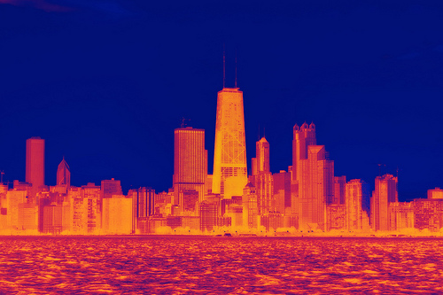
Heat Island Reduction
Option 1: Non-roof area ($$50 %)
Provide Shade with open structures
Paving materials with low solar reflectance index
Open-grid pavement (>50 % pervious)
Tree Shade
Option 2: Roofing
Highly reflective or vegetated
Option 3: Mix
www.globalchangeblog.com
Notes:
OPTION 1. Nonroof Measures
Use any combination of the following strategies for 50% of the nonroof site hardscape (including roads, sidewalks, courtyards, parking lots, parking structures, and driveways):
a. Provide shade from open structures, such as those supporting solar photovoltaic panels, canopied walkways, and vine pergolas, all with a solar reflectance index (SRI) of at least 29.
b. Use paving materials with an SRI of at least 29.
c. Install an open-grid pavement system that is at least 50% pervious.
d. Provide shade from tree canopy (within ten years of landscape installation).
OR
OPTION 2. High-Reflectance and Vegetated Roofs
Use roofing materials that have an SRI equal to or greater than the values in Table 1 for a minimum of 75% of the roof area of all new buildings within the project; or install a vegetated (“green”) roof for at least 50% of the roof area of all new buildings within the project. Combinations of SRI compliant and vegetated roofs can be used provided they satisfy the equation in Option 3.Combinations of SRI-compliant and vegetated roofs can be used provided they collectively cover 75% of the roof area of all new buildings (use the equation in Option 3).
Table 1. Minimum solar reflectance index value, by roof slope Roof slope SRI
Low (≤ 2:12) 78
Steep (> 2:12) 29

Slide 21
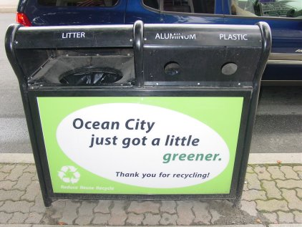
Solid Waste Management Infrastructure (1 point)
Recycling/Reuse Center
Hazardous Waste drop off center
Compost station
Recycling containers each block
Recycle/Reuse ≥ 50 % construction & demolition waste
bryan.ponnwitz.com

Slide 22
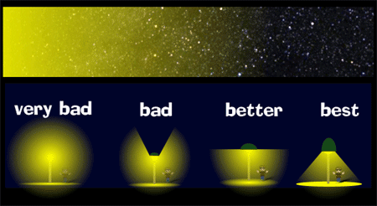
Light Pollution Reduction
Motion detectors
Daylight sensors
Light trespass restrictions
iusustain.files.wordpress.com
Notes:
GIB Credit 17: Light Pollution Reduction
1 point
Intent
To minimize light trespass from project sites, reduce sky-glow to increase night sky access, improve nighttime visibility through glare reduction, and reduce adverse effects on wildlife environments.
Requirements
“Shared areas” of a project are spaces and facilities dedicated to common use (publicly or privately owned).
In residential areas, at least 50% of the external luminaires must have fixture-integrated lighting controls that use motion sensors to reduce light levels by at least 50% when no activity has been detected for 15 minutes.
AND
In all shared areas, install automatic controls that turn off exterior lighting when sufficient daylight is available and when the lighting is not required during nighttime hours; these lights must meet the total exterior lighting power allowance requirements in Table 3.
AND
Document which lighting zone or zones (Table 1) describe the project, and for all shared areas, follow the requirements in Table 2. If two or more different zones border the project, use the most stringent uplight requirements, and use light trespass requirements for the adjacent zone. Roadway lighting that is part of the project must meet the requirements for the appropriate zone.
For illuminance generated from a single luminaire placed at the intersection of a private vehicular driveway and public roadway accessing the site, project teams may use the centerline of the public roadway as the site boundary for a length of two times the driveway width centered at the centerline of the driveway when complying with the trespass requirements.
Compliance with the light trespass requirements may alternatively be met by using only luminaires that comply with Table 4 ratings for backlight and glare.
AND
Stipulate covenants, conditions, and restrictions (CC&R) or other binding documents to require continued adherence to the requirements.
Table 1. Lighting zones Zone Definition
LZ0 Undeveloped areas within national parks, state parks, forest land and rural areas and sites immediately adjacent to areas officially recognized as ecologically sensitive by the local zoning authority.
LZ1 Developed areas within national parks, state parks, forest land and rural areas.
LZ2 Areas predominantly consisting of residential zoning, neighborhood business districts, light industrial with limited nighttime use, and residential mixed-use areas.
LZ3 All other areas not included in LZ0, LZ1, LZ2, or LZ4 (including commercial-industrial and high-density residential).
LZ4 High-activity commercial districts in major metropolitan areas (as designated by local jurisdiction, such as local

Slide 23
Innovation & Region
Innovation & Design Process
Innovation and Exemplary Performance
LEED Accredited Professional
Regional Priority Credit
Notes:
Italics are prerequisites
Updated to reflect the 10/1/2012 document addenda for the LEED 2009 for Neighborhood Development Rating System IDP Credit 1: Innovation and Exemplary Performance
1–5 points
Intent
To encourage exemplary performance above the requirements set by the LEED for Neighborhood Development Rating System and/or innovative performance in green building, smart growth, or new urbanismt categories not specifically addressed by the LEED for Neighborhood Development Rating System.
Requirements
In writing, identify the intent of the proposed innovation credit, the proposed requirement for compliance, the proposed submittals to demonstrate compliance, and the design approach and strategies that might be used to meet the requirements.
One point is awarded for each IDP Credit 1 earned, up to a total of 5. No more than 3 exemplary performance credits will be awarded in the Innovation and Design Process category.
IDP Credit 2: LEED Accredited Professional
1 point
Intent
To support the integrated planning and design required for a LEED for Neighborhood Development project and to streamline the application and certification process.
Requirements
At least one principal member of the project team must be a LEED Accredited Professional.
OR
At least one principal member of the project design team must be a professional who is credentialed in smart growth as determined by the Natural Resources Defense Council in consultation with Smart Growth America.
OR
At least one principal member of the project design team must be a professional who is credentialed in new urbanism as determined by the Congress for the New Urbanism.
Note: A separate LEED Accredited Professional exam track for professionals wanting to specialize in the LEED for Neighborhood Development Rating System will be available in early 2010; this IDP credit can be achieved if a principal member of the project design team is accredited as a result of passing the exam.
RPC Credit 1: Regional Priority
1–4 points
Intent
To encourage strategies that address geographically specific environmental, social equity, and public health priorities.
Requirements
Earn up to four of the six Regional Priority credits. These credits have been identified by subject matter experts representing the U.S. Green Building Council (regional councils and chapters), the Congress for the New Urbanism (chapters and membership in regions without chapters), and Smart Growth America (members of Smart Growth America’s State and Local Caucus or their designees) as having additional regional importance for the project’s location. A database of Regional Priority credits and their geographic applicability will be available on the USGBC website, www.usgbc.org.
One point is awarded for each Regional Priority credit earned, up to a maximum of 4. Non-U.S. projects are not eligible for Regional Priority credits.

